Slide 1


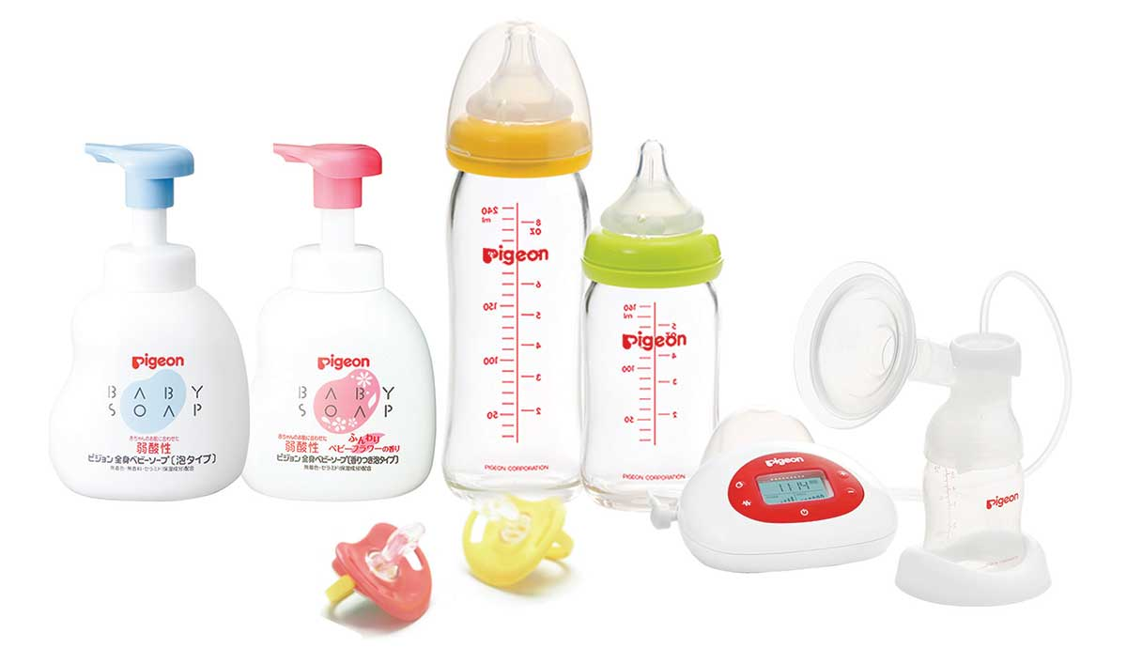
PPSU MILK BOTTLE
Campaign Tracking
Agency: Reputyze Asia
Client: Pigeon Vietnam
Period: August 01st – October 31th, 2019

Slide 7


GENDER
6.4%
88.9%
Others
4.7%
Location | Ratio
Hà Nội | 21.30%
Hồ Chí Minh | 8.90%
Nghệ An | 2.60%
Đà Nẵng | 2.60%
Đồng Nai | 1.30%
Others | 63.3%

